Slide 1
CSI1003 Formal Languages and Automata Theory
MODULE - 2
Dr. WI. Sureshkumar
Associate Professor
School of Computer Science and Engineering (SCOPE)
VIT Vellore
wi.sureshkumar@vit.ac.in
SJT413A34

Slide 2
Module -2
Finite State Automata
Finite automata
Deterministic Finite automata (DFA)
Non-deterministic Finite automata (NFA)
NFA with epsilon transitions
NFA without epsilon transition
Conversion of NFA to DFA
Equivalence of NFA and DFA
Minimization of DFA
Moors and Melay Machines.

Slide 3
Finite State Automata (FA)
One-way, infinite tape, broken into cells
Read-only tape head.
Finite control, i.e., finite number of states, and
A string is placed on the tape, read head is positioned at the left end.
FA will read the string one symbol at a time until all symbols have been read.
The FA will then either accept or reject the string.
0 | 1 | 1 | 0 | 0
Finite
Control

Slide 4
FSA Applications
Lexical analysis (Compiler) recognition of tokens
Thermostats (fridge)
Elevators
Train Track Switches
Text editing
Image compression
Computer Network

Slide 5
Deterministic Finite State Automata (DFA)
A deterministic finite automaton is a 5-tuple M = (Q, Σ, δ, q₀, F), where
Q - is a finite set of states
Σ - is a finite set of input symbols
q₀ ∈ Q - is the start state (initial state)
F ⊆ Q - is the set of accept states (final states)
δ : Q × Σ → Q - is the transition function

Slide 6
f : A → B
A
B
x₁
f(x₁) = y₁
x₂
f(x₂) = y₂
x₃
f(x₃) = y₃
.
.
.
x
f(x) = y

Slide 7
Q = {q₀ , q₁ } , Σ = { a, b}
n(Q) = 2 , n(Σ) = 2
A x B = { (x, y) / x ∈ A , y ∈ B } - Cartesian Product of A and B
n(A x B) = n(A) . n(B)
Q x Σ = { (q₀, a), (q₀, b), (q₁, a), (q₁, b) }
n(Q x Σ) = n(Q). n(Σ) = 2 . 2 = 4
δ : Q × Σ → Q

Slide 8
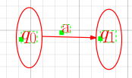
δ : Q × Σ → Q
δ(q₀, a ) = q₁
Q × Σ
Q
(q₀, a)
δ(q₀, a ) = q₁
(q₀, b)
δ(q₁, b ) = q₀
(q₁, a)
(q₁, b)

Slide 9
Examples
M = ( {q₀ , q₁ , q₂ , D } , {a, b} , q₀ , δ , {q₂} ) a b
where δ(q₀ , a) = q₁ δ(q₀ , b) = D q₀
δ(q₁ , a) = q₁ δ(q₁ , b) = q₂ q₁
δ(q₂ , a) = D δ(q₂ , b) = q₂ q₂
δ(D , a) = D δ(D , b) = D D
q₁ | D
q₁ | q₂
D | q₂
D | D
a
Transition Table or State Table
q₀
a
b
b
q₁
q₂
Transition diagram or State diagram
b
a
D
a , b

Slide 10
Extended Transition Function
Extend δ to
1)
2)
q₀
a
q₁
b
c
q₂
q₃

Slide 11
Grammar and Automata
L(M) is the of strings accepted by M
L(G) is the of strings generated by G
M - Automata is an accepting device of the language
G - Grammar is the generating device of the language

Slide 12
Examples
1)
2)
a
a , b
q₀
b
q₁
a , b
q₂
Trap state
a , b
q₁

Slide 13
3)
4)
a
q₀
q₁
b
b
a
D
a , b
a , b
a , b
q₀
q₁

Slide 14
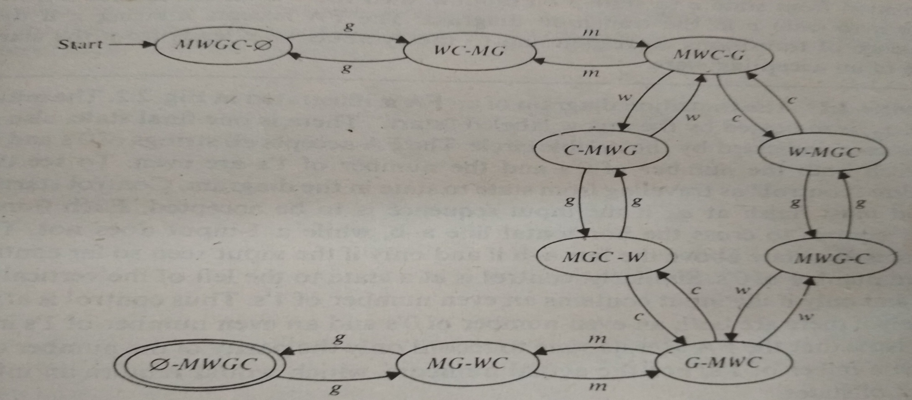
5)
W₁ =gmcgwmg W₂ =gmwgcmg

Slide 15
6)
a , b
q₀
q₁
a , b
a , b
a , b
a , b
a , b
a , b
a , b
q₂
q₂
q₂
q₂

Slide 16
7) FORTRAN identifier Max length = 6
8) Decimal Integer
A , B,…,Z,0,1,…9
A , B,…,Z,0,1,…9
A , B,…,Z,0,1,…9
A , B,…,Z,0,1,…9
A , B,…,Z,0,1,…9
A , B,…,Z
q₀
q₁
q₂
q₃
q₄
q₅
q₆
0,1,…9
0,1,…9
1,…9
.
q₀
q₁
q₂

Slide 17
DFA
Language accepted by a FSA is called regular set or regular language
Theorem: A language L is called regular if and only if there exists some deterministic finite accepter M such that
L = L(M)

Slide 18
Problems
Give DFA (DFSA) for the following languages:
L(G) = { ab^{n}a^{m} / n ≥ 2, m ≥ 3 }
L(G) = { w₁abw₂ / w₁ , w₂ ∈ {a, b}* }
L(G) = {w₁aw₂ / |w₁| ≥ 3, |w₂| ≤ 5}
L(G) = { w ∈{a, b}* / |w| mod 3 = 0}
L(G) = { w ∈{a, b}* / |w| mod 5 ≠ 0}
L(G) = { a^{n} / n ≥ 4 }
L(G) = { a^{n} / n ≠ 4 }
Let L = { a^{n}b / n≥ 0 }, find DFA for L².
L(G) = { a^{n} / n is either a multiple of 3 or a multiple of 5}
L(G) = { a^{n} / n is either a multiple of 3, but not a multiple of 5}

Slide 19
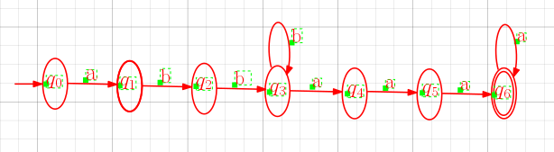
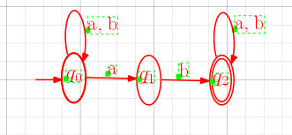
L(G) = { ab^{n}a^{m} / n ≥ 2, m ≥ 3 }
L(G) = { w₁abw₂ / w₁ , w₂ ∈ {a, b}* }

Slide 20
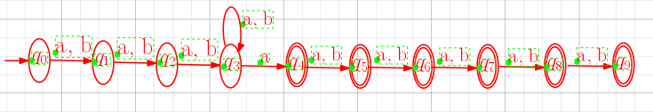
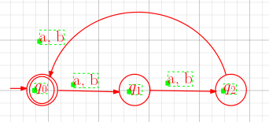
3) L(G) = {w₁aw₂ / |w₁| ≥ 3, |w₂| ≤ 5}
4) L(G) = { w ∈{a, b}* / |w| mod 3 = 0}

Slide 21
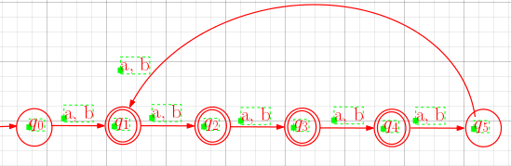
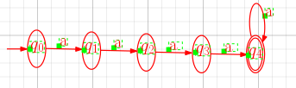
5) L(G) = { w ∈{a, b}* / |w| mod 5 ≠ 0}
= {a, b, aa, ab, ba, bb, aaa, aab, aba, abb , baa, bab, bba, bbb , . . .}
6) L(G) = { a^{n} / n ≥ 4 }

Slide 22
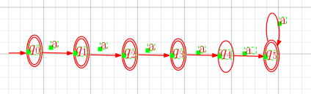
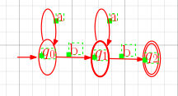
7) L(G) = { a^{n} / n ≠ 4 } = = {ε, a, a², a³, a⁵, a⁶ , a⁷, a⁸ , a⁹, a¹⁰ , . . .}
8) Let L = { a^{n}b / n≥ 0 }, find DFA for L².
L² ={b, ab, a²b, a³b , a⁴b , a⁵b, . . .}{b, ab, a²b, a³b , a⁴b , a⁵b, . . .}
={bb, bab, ba²b, ba³b , ba⁴b , ba⁵b, . . .abb, abab, aba²b, . . .}

Slide 23
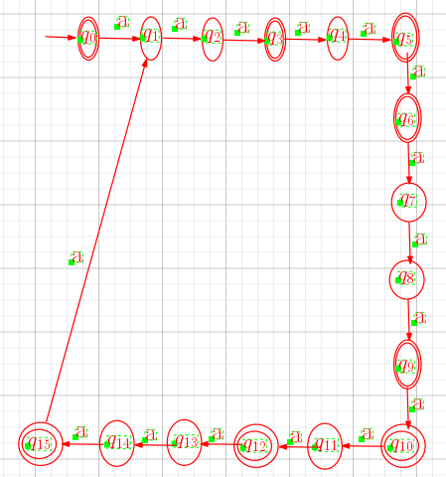
9) L(G) = { a^{n} / n is either a multiple of 3 or a multiple of 5}

Slide 24
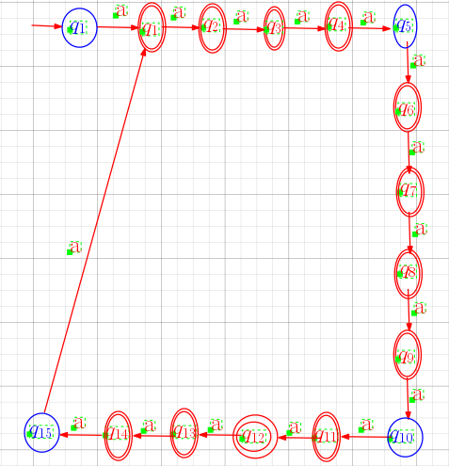
10) L(G) = { a^{n} / n is either a multiple of 3, but not a multiple of 5}

Slide 25
Non-deterministic Finite Automata (NFA)
A non-deterministic finite automaton is a 5-tuple M = (Q, Σ, δ, q₀, F), where
Q - is a finite set of states
Σ - is a finite set of input symbols
q₀ ∈ Q - is the start state (initial state)
F ⊆ Q - is the set of accept states (final states)
δ : Q × Σ → 2^{Q} - is the transition function
δ(q_{i} , a) = { q_{j} , q _{j} }

Slide 26
Q = {q₀ , q₁ } , Σ = { a, b}
n(Q) = 2 , n(Σ) = 2
ρ(Q) = 2^{Q} = { {q₀} , {q₁} , {q₀ , q₁ }, {ϕ} } - Power set of Q
n(2^{Q}) = 2^{n(Q)} = 2² = 4

Slide 27
δ : Q × Σ → 2^{Q}
δ(q_{i}, a ) = {q_{j} , q_{k}}
Q × Σ
2^{Q}
(q₀, a)
δ(q₀, a ) = {q₀ q₁}
(q₀, b)
δ(q₁, b ) = { q₀}
(q₁, a)
(q₁, b)
q_{j}
a
q_{i}
a
q_{k}

Slide 28
Example - 1
a
a
q₃
q₁
q₂
a
q₀
a
a
q₄
q₅
a

Slide 29
Example - 2
a
b
a
b
q₂
q₀
q₁

Slide 30
NFA to DFA (Procedure)
Create a graph with vertex . Identify this vertex as the initial vertex.
Repeat the following steps until no more edges are missing:
Take any vertex of that as no outgoing edge for some . Compute .
If
create a vertex for labeled if it does not already exist. Add to an edge from to
and labeled it with .

Slide 31
NFA to DFA (Procedure)
3. Every vertex of whose label contains any is identified as a final state.
4. If accepts , the vertex in is also a final state.

Slide 32
a
a
Example – 1
A
δ(q₀ , a) = {q₁ , q₄}
δ(q₁ , a) U δ(q₄ , a) = {q₂}U{q₅} = {q₂ , q₅}
q₁
q₂
q₃
a
q₀
a
a
q₄
q₅
a
q₀
a
q₁,q₄
q₀

Slide 33
δ(q₂ , a) U δ(q₅ , a) = {q₃}U{q₄} = {q₃ , q₄}
δ(q₃ , a) U δ(q₄ , a) = {ϕ}U{q₅} = {q₅}
a
q₁,q₄
a
q₀
q₂,q₅
a
a
a
q₀
q₁,q₄
q₂,q₅
q₃,q₄
a
q₁,q₄
a
a
a
q₀
q₂,q₅
q₃,q₄
q₅

Slide 34
δ(q₅ , a) = {q₄}
δ(q₄ , a) = {q₅}
a
a
a
a
a
q₀
q₁,q₄
q₂,q₅
q₃,q₄
q₅
q₄
a
q₀
a
q₁,q₄
a
a
a
a
q₂,q₅
q₃,q₄
q₅
q₄
a

Slide 35
Example – 2
δ(q₀ , a) = {q₀ , q₁}
δ({q₀ , q₁}, a) = δ(q₀ , a) U δ(q₁ , a) = {q₀ , q₁}U{ϕ} = {q₀ , q₁}
a
b
a
b
q₂
q₀
q₁
q₀
a
q₀,q₁
q₀
a
a
q₀,q₁
q₀

Slide 36
δ({q₀ , q₁}, b) = δ(q₀ , b) U δ(q₁ , b) = {ϕ}U{q₁ , q₂} = {q₁ , q₂}
δ({q₁ , q₂}, b) = δ(q₁ , b) U δ(q₂ , b) = {q₁ , q₂}U{ϕ}= {q₁ , q₂}
δ({q₀ , q₁}, b) = δ(q₀ , b) U δ(q₁ , b) = {ϕ}U{q₁ , q₂} = {q₁ , q₂}
δ({q₁ , q₂}, b) = δ(q₁ , b) U δ(q₂ , b) = {q₁ , q₂}U{ϕ}= {q₁ , q₂}
a
a
a
q₀,q₁
b
q₀
q₁,q₂
q₀
a
a
b
b
b
a
b
a
q₀,q₁
q₀
q₀,q₁
q₁,q₂
q₀

Slide 37
b
a
a
q₀,q₁
b
q₀
q₁,q₂

Slide 38
Problems
Find a DFA equivalent to the NFA with initial state p, final state q, and another state r having transitions:
δ(p , 0) = p , δ(p , 0) = q , δ(p , 1) = q , δ(q , 0) = r ,
δ(q , 1) = r , δ(r , 1) = r
2) Construct a DFA equivalent to the NFA with initial state p, final state q, and transitions:
δ(p , a) = p , δ(p , a) = q , δ(q , b) = q , δ(q , b) = p
Omit inaccessible states.

Slide 39
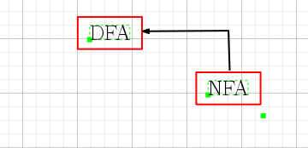

Slide 40
NFA with ε moves (ε-NFA)
A non-deterministic finite automaton with ε moves is a 5-tuple
M = (Q, Σ, δ, q₀, F), where
Q - is a finite set of states
Σ - is a finite set of input symbols
q₀ ∈ Q - is the start state (initial state)
F ⊆ Q - is the set of accept states (final states)
δ : Q × Σ U {ε } → 2^{Q} - is the transition function

Slide 41
ε-closure
ε-closure of a state q is the set of all states reachable from q through
ε-moves only and including q itself.
ε-closure(q₀) = {q₀ , q₁ , q₂ , q₃} ECLOSURE(q₀)
ε-closure(q₁) = { q₁ , q₂ , q₃}
ε-closure(q₂) = { q₂ , q₃}
ε-closure(q₃) = {q₃}
a
b
c
d
ε
ε
ε
q₀
q₁
ε
q₂
q₃

Slide 42
Q = {q₀ , q₁ } , Σ = { a, b} , Σ U {ε } = { a, b, ε}
n(Q) = 2 , n(Σ U {ε } ) = 3
Q x (Σ U {ε } ) = {(q₀, ε), (q₀, a), (q₀, b), (q₁, ε), (q₁, a), (q₁, b) }
ρ(Q) = 2^{Q} = { {q₀} , {q₁} , {q₀ , q₁ }, {ϕ} } - Power set of Q
n(2^{Q}) = 2^{n(Q)} = 2² = 4

Slide 43
δ : Q × ( Σ U {ε })→ 2^{Q}
δ(q_{i}, ε) = {q_{j} , q_{k}}
Q × (ΣU {ε })
2^{Q}
(q₀ , ε)
δ(q₀, ε ) = {q₀ q₁}
(q₀, b)
δ(q₁, b ) = { q₀}
(q₁, a)
(q₁, b)
(q₁ , ε))
q_{j}
ε
q_{i}
ε
q_{k}

Slide 44
Eliminating ε-transitions (Procedure)
Let M = (Q, Σ, δ, q₀, F) be an NFA with ε-moves. Then the equivalent DFA M’ = (Q’, Σ, δ’, q₀’, F’) is constructed as follows:
q₀’ = ε-closure(q₀) is the start state of M’
F’ is the set of states that contain at least one final state of M
δ’(S, a) is computed by,
let S = {p₁ , p₂ ,. . . ., p_{k}}
δ(p₁, a) U δ(p₂, a) U . . . . U δ(p_{k}, a)
δ’(S, a) = ε-closure(r₁) U ε-closure(r₂) U . . . . U ε-closure(r_{m})
ε-closure(r_{j})

Slide 45
Example-1
1
2
0
q₀
ε
q₁
ε
q₂
ε-closure(q₀) = {q₀ , q₁ , q₂ }
[q₀ , q₁ , q₂]

Slide 46
S = {q₀ , q₁ , q₂}
δ(S, 0) = δ(q₀, 0) U δ(q₁, 0) U δ(q₂, 0) = {q₀} U{ϕ}U{ϕ}= {q₀}
δ’(S, 0) = ε-closure(q₀) = {q₀ , q₁ , q₂}
δ(S, 1) = δ(q₀, 1) U δ(q₁, 1) U δ(q₂, 1) ={ϕ} U {q₁} U{ϕ}= {q₁}
δ’(S, 1) = ε-closure(q₁) = { q₁ , q₂}
0
[q₀ , q₁ , q₂]
0
[q₀ , q₁ , q₂]
1
[q₁ , q₂]

Slide 47
δ(S, 2) = δ(q₀, 2) U δ(q₁, 2) U δ(q₂, 2) ={ϕ} U {ϕ} U {q₂} = {q₂}
δ’(S, 2) = ε-closure(q₂) = { q₂}
0
[q₀ , q₁ , q₂]
1
2
[q₁ , q₂]
[ q₂]

Slide 48
S = {q₁ , q₂}
δ(S, 1) = δ(q₁, 1) U δ(q₂, 1) = {q₁} U{ϕ}= {q₁}
δ’(S, 1) = ε-closure(q₁) = {q₁ , q₂}
0
[q₀ , q₁ , q₂]
1
2
1
[q₁ , q₂]
[ q₂]

Slide 49
δ(S, 2) = δ(q₁, 2) U δ(q₂, 2) = {ϕ} U {q₂} = {q₂}
δ’(S, 2) = ε-closure(q₂) = {q₂}
0
[q₀ , q₁ , q₂]
1
2
[q₁ , q₂]
2
1
[ q₂]

Slide 50
S = {q₂}
δ(S, 2) = δ(q₂, 2) = {q₂} = {q₂}
δ’(S, 2) = ε-closure(q₂) = {q₂}
0
0
[q₀ , q₁ , q₂]
[q₀ , q₁ , q₂]
1
1
2
2
2
2
2
[q₁ , q₂]
2
1
[q₁ , q₂]
1
[ q₂]
[ q₂]

Slide 51
0
0
p₀
p₀
1
1
2
2
2
2
2
p₁
2
1
p₁
1
p₂

Slide 52
Example-2
a
b
c
d
ε
ε
ε
q₀
q₁
ε
q₂
q₃
ε-closure(q₀) = {q₀ , q₁ , q₂ , q₃}
ε-closure(q₁) = { q₁ , q₂ , q₃}
ε-closure(q₂) = { q₂ , q₃}
ε-closure(q₃) = {q₃}

Slide 53
a
[q₀ , q₁ , q₂ , q₃]
b
d
d
b
[q₁ , q₂ , q₃]
d
[q₃]
c
d
c
[ q₂ , q₃]
c

Slide 54
Problems:
Draw the transition diagram of the NFA with initial state p, final state q, and another state r, having transitions
δ( p , 0) = q , δ(p , 1) = q , δ(q , 0) = p , δ(q , 1) = q , δ(q , 0) = r ,
δ(q , ε) = r , δ(r , 1) = q
Which language does it accept? Find its equivalent DFA.
2) Find the DFA equivalent to the following NFA with ε edges.
δ( a , ε) = {b, c} , δ(b , 0) = d , δ(d , 0) = e , δ(e , 0) = b , δ(c , 0) = f ,
δ(f , 0) = g , δ(g , 0) = h , δ(h , 0) = i , δ(i , 0) = c
Where a is an initial state, b and c are two final states.

Slide 55
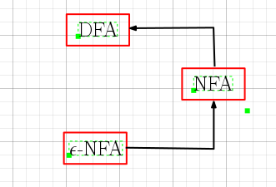

Slide 56
Regular Expression
Let Σ be a given alphabet. Then
∅ , ε , and any a∈Σ are all regular expressions. These are called
primitive regular expressions.
2) If r₁ and r₂ are regular expressions, then
- r₁ + r₂ is a regular expression.
- r₁ ⋅ r₂ is a regular expression.
r₁* is a regular expression.
(r₁ ) is a regular expression.
3) A string is a regular expression, if and only if it can be derived from the primitive regular expressions by a finite number of applications of rules in (2).

Slide 57
Regular Expression
Check whether the given string is a regular expression,
={ a, b, c}, the string (a + b . c)* . (c + ∅)
r₁ = a , r₂ = b , r₃ = c
r₄ = r₂ . r₃ = b . c
r₅ = r₁ + r₄ = a + b . c
r₆ = (r₅) = (a + b . c)
r₇ = r₆* = (a + b . c)*
r₈ = ∅
r₉ = r₃ + r₈ = c + ∅
r₁₀ = (r₉)= (c + ∅)
r₁₁ = r₇ . r₁₀ = (a + b . c)* . (c + ∅)

Slide 58
Languages associated with regular expressions
The language L(r) denoted by a regular expression r is defined by the following rules,
∅ is a r.e denoting the empty set L (∅) = {∅}
ε is a r.e denoting the empty set L (ε) = {ε}
For any a∈Σ is a r.e denoting the set L (a) = {a}
If r₁ and r₂ are regular expressions, then
4) L (r₁ + r₂) = L{r₁} U L{r₂}
5) L (r₁ . r₂) = L{r₁}.L{r₂}
6) L ((r₁)) = L(r₁)
7) L (r₁*) = (L (r₁))*

Slide 59
Languages associated with regular expressions
Exhibit the language L(a* . (a + b)) in set notation
L(a* . (a + b)) = L(a*) . L( (a + b))
= (L(a))*. L(a + b))
= (L(a))*. L(a) U L(b)
= { a }*. { a } U { b }
= {ε, a, aa, aaa,. . . }. { a, b}
= {a, aa, aaa, aaaa,. . . ,b, ab, aab, aaab,. . . }

Slide 60
Languages associated with regular expressions
r = (a + b)*. (a + bb), find L(r)
L(r) = L((a + b)*. (a + bb))
= L((a + b)*). L(a + bb)
= (L(a + b))*. L(a + bb)
= (L(a) U L(b))* . L(a) U L(bb)
= {a, b}* . {a} U {b}.{b}
= {a, b}* . {a} U {bb}
= {a, b}* . {a, bb}
= {ε, a, b, aa, ab, ba, bb,. . .} . {a, bb}
= {a, aa, ba, aaa, aba, baa, bba,. . .,bb, abb, bbb, aabb, abbb, . . .}

Slide 61
Examples
Describe the following sets by regular expressions
L₁ = the set of all strings of 0’s and 1’s ending with 00
L₂ = the set of all strings of 0’s and 1’s and beginning with 0 and ending with 1
L₃ = {ε, aa, aaaa, . . . }
The set of all strings of 0’s and 1’s with at least two consecutive zeros
The set of all strings of a’s and b’s whose length is divisible by 6
The set of all strings of a’s and b’s whose 5th last symbol is b
The expression r = (aa)* (bb)*b denotes the set of strings with an even number of a’s followed by an odd number of b’s
L₄ = {a^{n} b^{m} / n ≥ 4 , m ≤ 3}

Slide 62
Examples
1) (0 + 1)*00
0(0 + 1)*1
(aa)*
(0 + 1)*00(0 + 1)*
[(a + b)⁶]*
(a + b)*b(a + b)4
7) L(r) = {a^{2n} b^{2m+1} / n ≥ 0 , m ≥ 0 }
8) aaaaa*(ε + b + bb + bbb)

Slide 63
Regular expression to ε-NFA
Theorem: Let r be a regular expression, then there exists some NFA with ε-moves that accept L(r). Consequently, L(r) is a regular language.
Proof: We begin with automata that accepts the language for primitive regular expressions ∅ , ε , and any a∈Σ
a) NFA accepts ∅
b) NFA accepts ε c) NFA accepts a∈Σ
q₀
q_{f}
ε
q₀
a
q_{f}
q₀
q_{f}

Slide 64
Regular expression to ε-NFA
ii) NFA accepts L(r)
iii) NFA accepts L(r₁+r₂)
M(r)
M(r₁)
ε
ε
M(r₂)
ε
ε

Slide 65
Regular expression to ε-NFA
iii) NFA accepts L(r₁.r₂)
iii) NFA accepts L(r₁*)
M(r₁)
M(r₂)
ε
ε
ε
M(r₁)
ε
ε
ε

Slide 66
Examples
The set of integers
(1+2+. . . +9)(0+1+. . . +9)*
2)The set of decimal numbers
(1+2+. . . +9)(0+1+. . . +9)*. (0+1+. . . +9)*
3) Strings over {a, b} and length multiple of 3
[(a + b)(a + b)(a + b)]*

Slide 67
Examples
(0 + 01)*
(a + b)*b(a + bb)*
(a+b)*abb
aa* + ab a*b*
(abab)* + (aa*+ b)*
((00*)*1)*
(01)* + 1(01)* + (01)*0 + 1(01)*0

Slide 68
(0 + 01)*
0
1
01
0
1
0
ε
1

Slide 69
0 + 01
(0 + 01)*
0
ε
ε
ε
ε
0
ε
1
ε
0
ε
ε
ε
ε
ε
ε
ε
0
ε
1
ε

Slide 70
(a + b)*b(a + b)*
a
b
a + b
a
b
a
ε
ε
ε
b
ε

Slide 71
(a+b)*
ε
a
ε
ε
ε
ε
ε
b
ε
ε

Slide 72
(a + b)*b(a + b)*
ε
ε
a
a
ε
ε
ε
ε
ε
b
ε
ε
ε
ε
ε
ε
b
ε
b
ε
ε

Slide 73
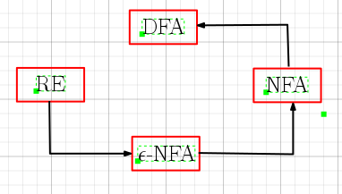

Slide 74
DFA to Regular Expressions
Theorem: If L = L(A) for some DFA A, then there is a regular expression r such that L = L(r)
Theorem: (Arden’s Theorem)
Let P and Q be two regular expressions over Σ. If P does not contain ε, then the following equation in R,
R = RP + Q
has unique solution, given by
R = P*Q

Slide 75
Algebraic Method using Arden’s Theorem
The following method is an extension of Arden’s theorem. It is used to find r.e recognized by the transition system.
The following assumptions are made regarding the transition system:
1) The transition system does not have ε-moves
2) It has one initial state say v₁
3) Its vertices are v₁ , v₂ , . . .,v_{n}
4) α_{ij} denotes the r.e representing the set of labels of edges from v_{i} to v_{j}, when there is no edge, α_{ij} = ∅. Consequently, we can get the following set of equations in v₁ , v₂ , . . .,v_{n}

Slide 76
Algebraic Method using Arden’s Theorem
v₁ = α₁₁ v₁+ α₁₂ v₂ + . . . .+ α_{1n} v_{n}
v₂ = α₂₁ v₁+ α₂₂ v₂ + . . . .+ α_{2n} v_{n}
. . . . . . . . . . . . . . . . . . . . . .
. . . . . . . . . . . . . . . . . . . . . .
v_{i} = α_{i1} v₁+ α_{i2} v₂ + . . . .+ α_{in} v_{n}
. . . . . . . . . . . . . . . . . . . . . .
. . . . . . . . . . . . . . . . . . . . . .
v_{n} = α_{n1} v₁+ α_{n2} v₂ + . . . .+ α_{nn} v_{n} + ε
By repeatedly applying substitutions and Arden’s theorem, we can express v_{i} in terms of α_{ij}

Slide 77
Examples
a
1)
Since there are 4 states namely q_{0 ,} q_{1 ,} q₂ and q₃ , therefore we have 4 equations,
q₀ = ε + a q₁ + b q₂ ----------- (1)
q₁ = b q₀ + a q₃ ----------- (2)
q₂ = a q₀ + b q₃ ----------- (3)
q₃ = a q₃ + b q₃ ----------- (4)
q₀
q₁
b
a
a
b
a , b
q₂
b
q₃

Slide 78
From (4),
q₃ = q₃ (a + b) + ∅
By applying Arden’s theorem,
q₃ = (a + b)* ∅ = ∅ -----------(5) a. ∅ = ∅
Sub. (5) in (3) and (4), we get a. ε = a
q₂ = a q₀ -----------(6)
q₁ = b q₀ -----------(7)
Sub. (6) and (7) in (1), we get
q₀ = ε + ab q₀ + ba q₀
= (ab + ba) q₀ + ε
By applying Arden’s theorem,
q₀ = (ab + ba)* ε = (ab + ba)*

Slide 79
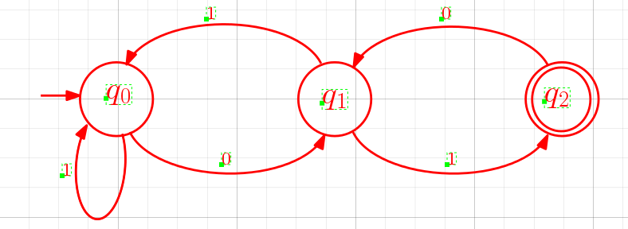
1) Construct the regular expression for the following FSA:
Since there are 3 states namely q_{0 ,} q₁ and q₂ , therefore we have 3 equations,
q₀ = 1 q₀ + 0 q₁ ----------- (1)
q₁ = 1 q₀ + 1 q₂ ----------- (2)
q₂ = ε + 0 q₁ ----------- (3)

Slide 80
Sub. (3) in (2), we get
q₁ = 1 q₀ + 1 (ε + 0 q₁)
= 1 q₀ + 1 + 10 q₁
= 10 q₁ + (1 + 1 q₀)
By applying Arden’s theorem,
q₁ = (10)* (1 + 1 q₀)
= (10)* 1 + (10)* 1 q₀ -----------(4)
Sub. (4) in (1), we get
q₀ = 1 q₀ + 0 [ (10)* 1 + (10)* 1 q₀]
= [1 + 0(10)* 1] q₀ + 0(10)* 1
By applying Arden’s theorem,
q₀= [1 + 0(10)* 1]* 0(10)* 1

Slide 81
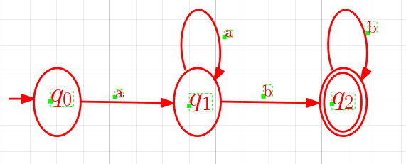
2)
Since there are 3 states namely q_{0 ,} q₁ and q₂ , therefore we have 3 equations,
q₀ = aq₁ ----------- (1)
q₁ = a q₁ + b q₂ ----------- (2)
q₂ = ε + b q₂ ----------- (3)

Slide 82
From (3),
q₂ = b q₂ + ε
By applying Arden’s theorem,
q₂ = b* ε = b* -----------(4)
Sub. (4) in (2), we get
q₁ = a q₁ + b b*
By applying Arden’s theorem,
q₁ = a* b b* -----------(5)
Sub. (5) in (1), we get
q₀ = a a* b b*

Slide 83
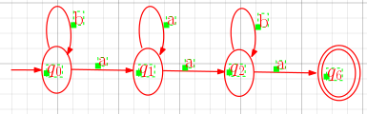
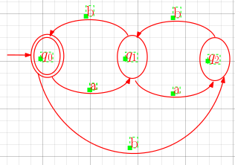
Find regular expressions for the languages accepted by the following automata:-
1)
2)

Slide 84
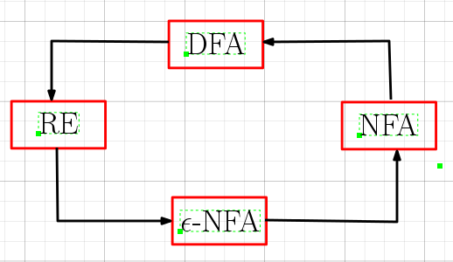

Slide 85
Minimization of Automata
Example-1
0
q₀
q₁
0
1
1
q₂
q₃
0
1
1
0
0 , 1
q₄
q₅
1
0

Slide 86
Minimum State Automaton
0 , 1
0
0
J₀ U J₁
1
1
J₂ U J₃ U J₄
J₅
0 , 1
0
0
1
1
[ε]
[1]
[11]
The minimum state automaton accepting L is unique

Slide 87
Let M be a DFA. Let ≡ be the equivalence relation on the states of M such that
p is equivalent to q
p ≡ q if for any x in Σ*
δ(p , x) and δ(q , x) are both in F or both not in F
p and q are distinguishable if there exists x in Σ*
δ(p , x) ∈ F δ(q , x) F
or
δ(p , x) F δ(q , x) ∈ F
x is called the distinguishable sequence.

Slide 88
Minimization of Automata
Example-1
0
q₀
q₁
0
1
1
q₂
q₃
0
1
1
0
0 , 1
q₄
q₅
1
0

Slide 90
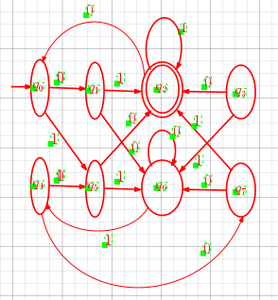
Example-2

Slide 92
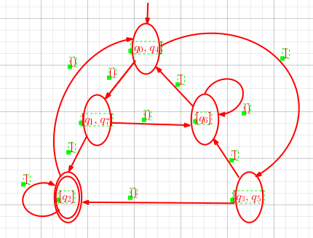

Slide 93
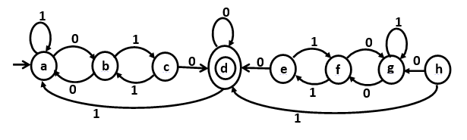
Example-3

Slide 95
